Slide 1
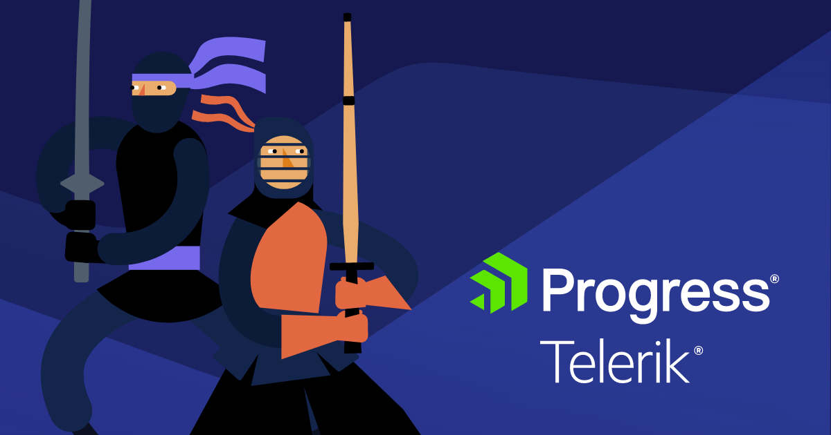


Samar Abu Hdeeb

Slide 2

Telerik overview
Key Offerings:
Telerik is a software development company that provides tools and technologies to enhance the development of web, mobile, and desktop applications
UI Components: e.g Angular, React, Vue
Kendo UI: focused on delivering JavaScript-based UI components for frameworks like Angular
Reporting and Analytics Tools: Telerik Reporting
Cross-Platform Development:
Provides tools for hybrid and native mobile app development
It is part of Progress Software Corporation and is well-known for its developer-focused products and solutions.
Notes:
aimed at software developers and teams working on application development, Telerik’s tools are designed to save time and provide high-quality, responsive, and modern designs.
Progress Software Corporation is a global software company that provides tools, platforms, and solutions for businesses to build, deploy, and manage applications and digital experiences
Kendo UI: A flagship product focused on delivering JavaScript-based UI components for frameworks like Angular, React, and Vue.
Provides tools for hybrid and native mobile app development, often integrated with frameworks like Xamarin or other platforms.

Slide 3

Project Overview
Home page tests
Account
Contact us
Buttons in home page
Links in nav bar(titles)
Demo page:
Anchors lead to right section
All tests conducated in an OOP manner
Black box testing
Functionality

Slide 4

HOME PAGE TESTS
Test titles - (5 methods) for each element in navbar after click at it insure that the correct page is opened with correct title
Buttons - 6 methods, test clicking buttons in home page
Demos - 8 methods of tests in nav bar of Demos bage

Slide 5
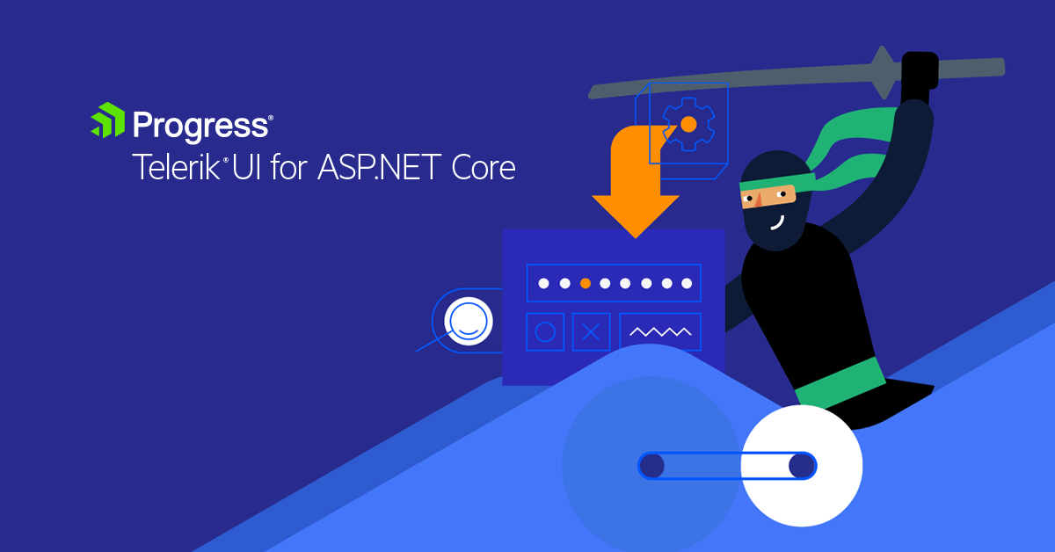
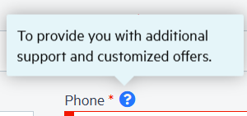

ACCOUNT
CONTACT US
Empty field
Symbols
Change email button
Tooltip: phone number field, country fields
Empty fields: password, country
Valid input
Empty fields
Special chars and symbols
Tooltip
Invalid

Slide 6

To Testes Github

Slide 7


THANK YOU

